Slide 1
Intel Unnati Industrial Training 2025
PROBLEM STATEMENT
CONVERTING ENTERPRISE PDFS INTO SEARCHABLE KNOWLEDGE USING RETRIEVAL-AUGMENTED GENERATION
Submitted by
Salmali Samanta(CSE-DS/22/34) Mayukh Adhikari(CSE-DS/22/54) Rounak Kumar Singh((CSE-DS/22/12)

Slide 2
INTRODUCTION
Enterprises store critical knowledge in PDF documents such as policies, manuals, reports, and research papers.
While PDFs preserve formatting, they are unstructured and difficult for machines to understand.
As a result, retrieving accurate information from large document collections is inefficient and time-consuming.
This project focuses on converting enterprise PDFs into searchable, structured knowledge using RAG.

Slide 3




PROBLEM STATEMENT
PDFs lack semantic structure
Keyword-based search fails to understand context Scanned documents require OCR
Tables, charts, and images are not searchable Multilingual documents increase complexity
These issues lead to poor information retrieval and reduced productivity.

Slide 4

PROJECT OBJECTIVES
Extract text from digital and scanned PDFs Preprocess and clean extracted content Segment documents into semantic chunks
Enable semantic search using vector embeddings Generate accurate answers using RAG
Support multilingual queries

Slide 5
PROPOSED SOLUTION
The system combines document retrieval with controlled language generation.
OCR extracts text from PDFs
Text is cleaned and semantically chunked
Vector embeddings represent document meaning Relevant content is retrieved using similarity search
RAG generates responses grounded in retrieved documents This ensures accuracy and minimizes hallucination.

Slide 6

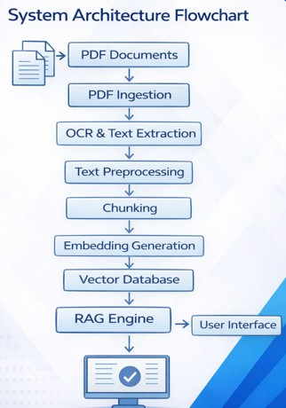

SYSTEM ARCHITECTURE
The system consists of:
PDF Ingestion
OCR and Text Extraction
Text Preprocessing and Chunking Embedding Generation
Vector Database
Retrieval-Augmented Generation Engine User Interface
This modular design supports scalability and enterprise use.

Slide 7
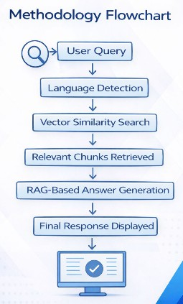
METHODOLOGY
Ingest enterprise PDFs
Apply OCR to scanned documents
Clean and normalize text
Split content into semantic chunks
Generate and store embeddings
Process user queries
Retrieve relevant chunks
Generate grounded responses using RAG

Slide 8


BUSINESS & ENGINEERING IMPACT
Faster access to enterprise knowledge Reduced manual document search Improved decision-making
Applicable across HR, compliance, engineering, and research teams

Slide 9

RELEVANCE TO INTEL
Addresses large-scale enterprise documentation challenges
Demonstrates end-to-end system design
Relevant to AI/ML, Data, Software, and Research roles Aligns with reliable and responsible AI principles

Slide 10
CONCLUSION
This project demonstrates a practical enterprise AI system for transforming PDFs into searchable knowledge.
By combining OCR, semantic search, and RAG, it overcomes the limitations of traditional document search and delivers accurate, scalable, and reliable information retrieval.

Slide 11
THANK YOU

